Slide 1
Distinguish abnormal individuals from Neck laser data
Supervised by: Professor Jie Wei
Presented by: Md Ayub Ali Sarker
Notes:
Our project title is Distinguish ….

Slide 2
Problem statement
Neck laser data is collected from three group of peoples(A:18~30, B:31~50 and C:50+). Each observation contains multiple signal files, and each file is 1D signal values in time domain.
We also have participant information that contains pulse and health issues of each individual.
Motivation: Our laser sensor is remote sensor. It can measure bio sign from 10m. In theory, it could be 400~500m. This can be used to determine remote bio sign. Like covid-19 and other serious illness. That's why I am motivated.
In this work, We extracted features from signal in time and frequency domain, We determined heartbeat of each individual and health condition (Normal and Not Normal) using signal processing and machine learning technique.

Slide 3
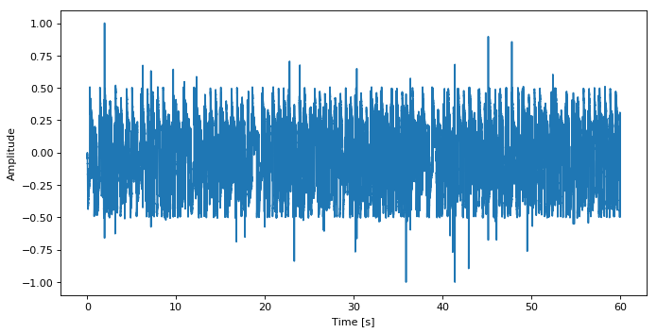
Neck Laser Data
Neck Laser data contains the human pulse vibrations over the neck artery collected by a laser droppler vibrometer. Each observation is collected for a person from multiple left and right-side scans and saved in .mat format. Each file is the 60 seconds duration with sampling rate 44,100 Hz. We have total of 235 mat files of 39 persons of three groups.
We also have participant data that contains information like Health issue, Pulse, Age, Sex, Blood pressure, Ethnicity and Weight.
Notes:
Here is the smaple neck laser data looks in time domain

Slide 4
Solution to the problem
In order to address this problem, we did follow major tasks
Heartbeat extraction
Extract features in time and frequency domain
Extract Level from participant data
Feature Selection
Feed the model with original data
Generate 200 synthetic data using TCGAN
Feed the model with original plus synthetic data

Slide 5
Heartbeat Extraction
We developed two procedures to extract heartbeat from signal
Clustering Approach
Average Approach
Notes:
we developed two procedures to extract heartbeat from signals.
One is Clustering Approach
Other is Average Approach
In clustering approch...
In Average approch

Slide 6
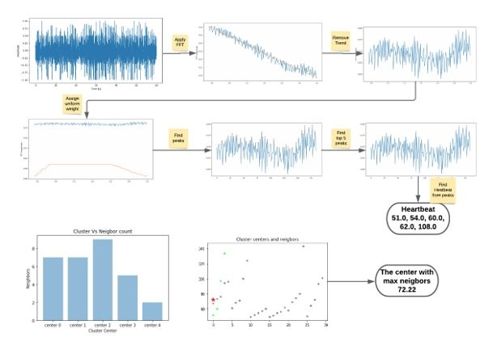
Heartbeat Extraction- Clustering Approach
Notes:
Here is the Original signal in time domain--> |we Applied FFT| --> we got signal in frequency domain --> | Removed trend from the signal |
--> | then we assigned uniform weigth in between 0.8~2.5hz | --> Find the peaks from the signal--> then found out top 5 peaks from signal,
--> for each peak we determined the heartbeat by multiply peak frequency with 60s -> combined all set of heartbeat for each file and did KmeanId clustering
--> found out cluster with max neighbors and took center as the final heartbeat of that individual

Slide 7
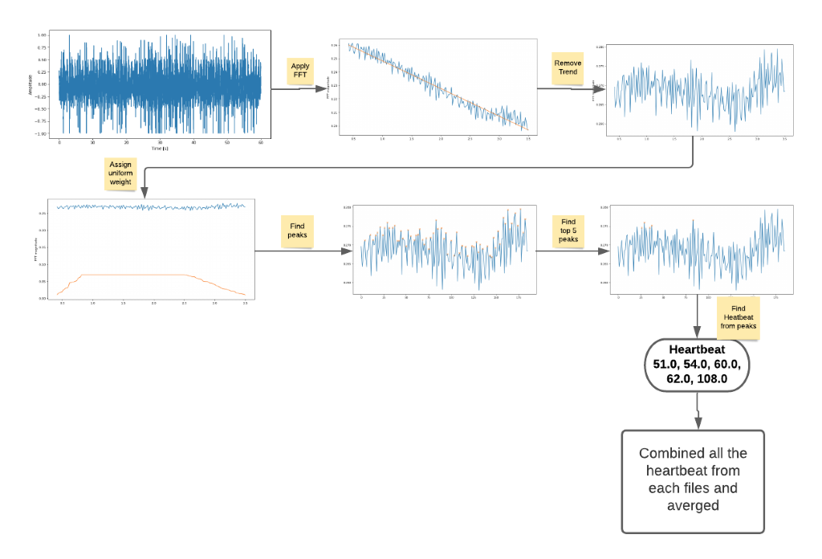
Heartbeat Extraction- Average Approach
Notes:
It is kinda similar to first approach.
Here is the Original signal in time domain--> |we Applied FFT| --> we got signal in frequency domain --> | Removed trend from the signal |
--> | then we assigned uniform weigth in between 0.8~2.5hz | --> Find the peaks from the signal -->then found out top 5 peaks in the signal
--> for each peak we determined the heartbeat by multiply peak frequency with 60s -> combined all set of heartbeat for each file and did average of all the heartbeats and took average value as the final heartbeat for that individual

Slide 8
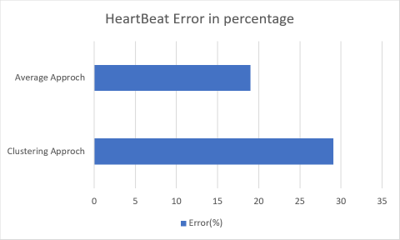
Heartbeat Extraction
We compared the derived heartbeat with actual heartbeat from the participation data. We calculated error of each approach.
We took heartbeat calculated from average approach as the final heartbeat to use in later machine learning approach
Notes:
Average approach (19%) is better than Clustering Approach (29%). So, we took heartbeat calculated from average approach as the final heartbeat to use in later machine learning approach

Slide 9
Extract features in time and frequency domain
Feature extraction in frequency spectrum: We divided the signal in frequency domain into six bands and found out peak frequency as a feature in that band using cluster approach. Those bands are
0~0.7hz
2.6~10hz
11~20hz
21~30hz
31~40hz
41~50hz
Feature extraction in time domain: We extracted following features from the signal in time domain
Zero crossing rate average
Spectral rolloff average
Spectral centroid average
Spectral bandwidth average
Poly features average
RMS average
Spectral flatness average
Notes:
Feature extraction in time domain: We extracted some features from original signal in time domain in a sense that those features might play important role in machine learning algorithm. Those are

Slide 10
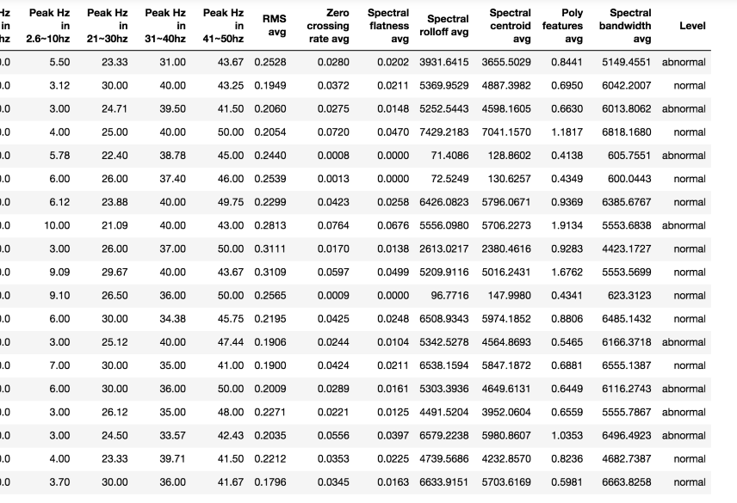
Extract Level from participant data
Participant data contains health issues of each individual. We used this health issues information as an indication of health condition (Normal/ Not Normal)
Notes:
After extracting all the features, We extract level for our data.

Slide 11
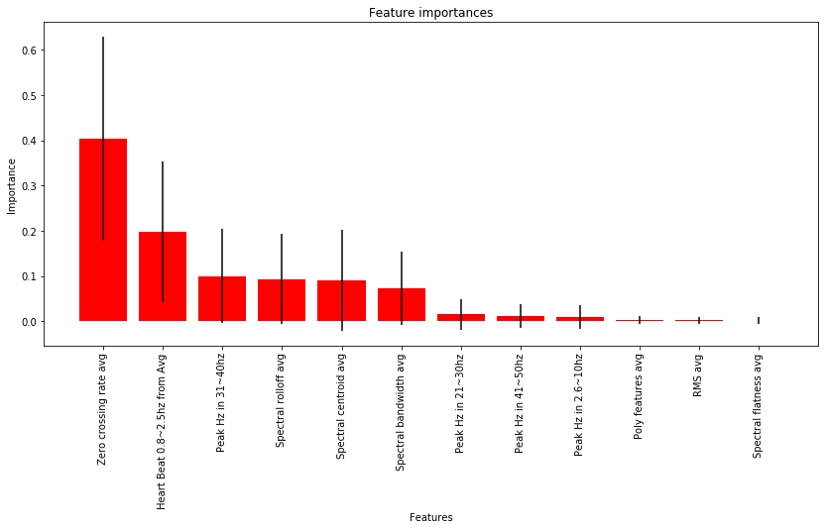
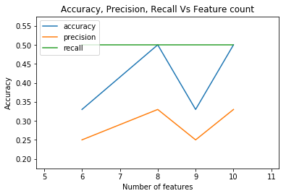
Feature Selection
We used RandomForestClassifier to see feature’s importance.
We can see the zero-crossing rate average has the highest contribution, then Heartbeat and peak frequency between 31~40Hz and then spectral Rolloff frequency and so on.
In order to found out top important sets of features we feed RandomForestClassifier to five different sets of top important features [6, 8, 9, 10]. and plot the accuracy, precision and recall
We can see that recall are same for all, but accuracy and procession are higher in 8 sets of features. So, we used first 8 importance features to feed our model
Notes:
Here we can see the zero-crossing rate average has the highest contribution, then Heartbeat and peak frequency between 31~40Hz and then spectral Rolloff frequency and so on. Some features like ploy features average, RMS average and spectral flatness avg has the lowest contribution

Slide 12
Feed the model with original data
Model | Accuracy
AdaBoostClassifier | 67%
DecisionTreeClassifier | 67%
KNeighborsClassifier | 50%
RandomForestClassifier | 50%
Notes:
We feed our models with original data and got accuracy listed in the table

Slide 13
Generate 200 synthetic data using TCGAN
We have small set of observations. A small data set suffers from high bias and overfitting. Getting more data in our case it very difficult and costly.
We used TCGAN to generate 200 synthetic data. We used that 200 synthetic plus original data to feed our model.

Slide 14
Feed the model with original plus synthetic data
Model | Accuracy
AdaBoostClassifier | 71%
DecisionTreeClassifier | 62%
KNeighborsClassifier | 74%
RandomForestClassifier | 73%
Notes:
Here the result we got after feeding our models with original plus synthetic date. Here is accuracy listed in the table.

Slide 15
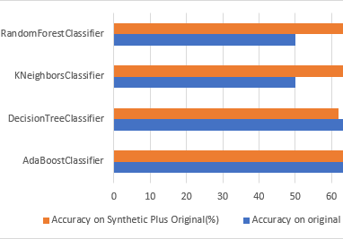
Summary of result
Looking at the result we can see that Adaboost has moderate accuracy as 67% original and 71% in synthetic plus original data.
Although Random forest(73) and KNN(74) has high accuracy in synthetic plus original data but they have low accuracy in original data
So Adaboost is the best choice for our data set
Notes:
Here is the summary of acuracy of our models

Slide 16
Conclusion and Future plan
We have small set of data. Most experimental involving primary research with real people have small data due to cost of conduction in person. In our case, this collection process is costly, too difficult and time-consuming. That's why we used to TCGAN to generate some synthetic data.
We tried four different classifiers like AdaBoost, Decision Tree, KNN and Random Forest. We saw that Adaboost is the best choice.
In future we planned to extend this work to identify sex and age group of individual
https://github.com/msarker000/dse-capstone

Slide 17
Question?

